Slide 1
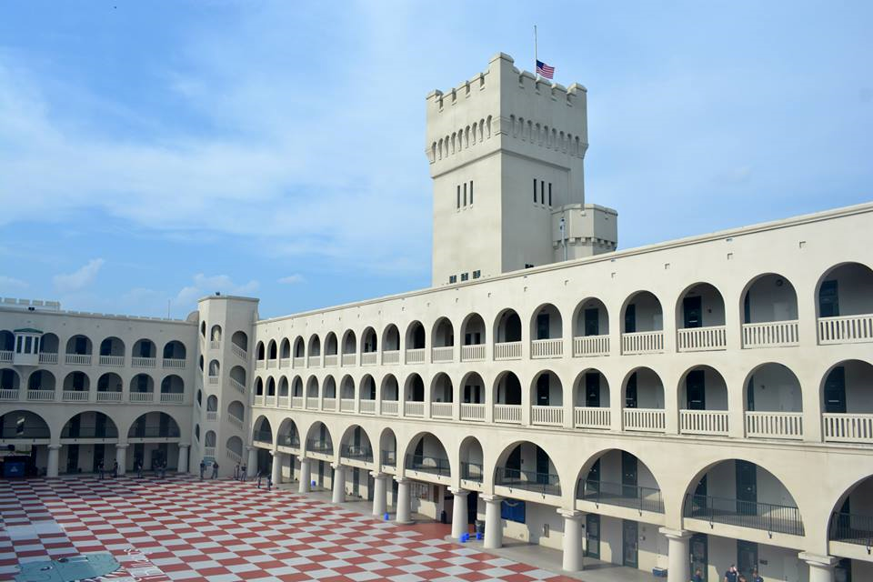
Mentor Partnerships between Colleges and K-12 Schools:
Perspectives from College Students Who Mentor

Slide 2
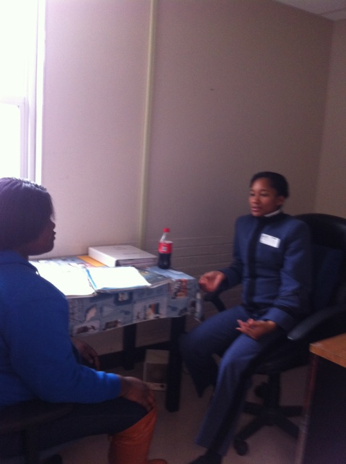
Objectives
Highlight ideas for building mentor partnerships between colleges and K-12 schools
Present tips for establishing positive rapport, serving as constructive role models, and fostering trusting relationships with mentees
Offer perspectives on mentoring and lessons learned from current and past mentors

Slide 3
Partnering with K-12 Schools
Approached by school personnel during field experiences
Contacted by former students now teaching or counseling
Developed mentor partnerships at requests of schools
Researched best mentoring practices
Based partnerships on schools’ distinct needs
“Everyone needs a coach, whether it’s a top level executive, a graduate student, a homemaker, a homeless person or the President of the United States” - Anthony Robbins

Slide 4
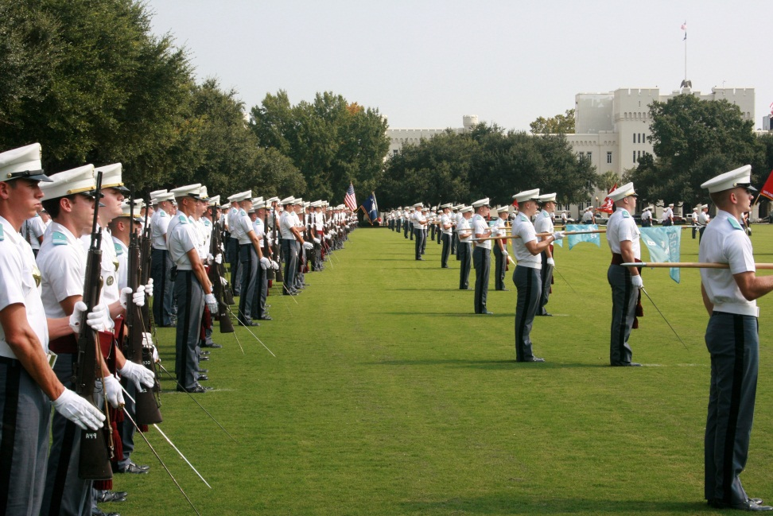
Finding Strong Mentors
Partnered with The Citadel’s African American Society
Announced mentoring opportunities in education courses
Sought recommendations from Tactical Officers
Spoke to students one-on-one
Developed online application process

Slide 5
Utilizing Best Practices
Assigned School-Based Prescriptive Mentoring (Anastasia, Skinner, and Mundhenk, 2012)
Natural School-Based Developmental Mentoring
(Anastasia, Skinner, & Mundhenk, 2012)
Paired with specific mentees needing assistance with academics, time management and organization, and/or positive attention
Worked to establish rapport, build trust, and serve as positive role models while participating in recreational activities
“Mentoring brings us together – across generation, class, and often race – in a manner that forces us to acknowledge our interdependence, to appreciate, in Martin Luther King, Jr.’s words, that ‘we are caught in an inescapable network of mutuality, tied to a single garment of destiny.’ In this way, mentoring enables us to participate in the essential but unfinished drama of reinventing community, while reaffirming that there is an important role for each of us in it.”
- Marc Freedman

Slide 6
Knowing What to Do
Set a good first impression
Look confident, wait for invitation (if appropriate)
Ice-breaker activities (bingo, basketball, etc.)
Learn their names
Introduce yourself (practice good manners)
Establish relationship with staff/faculty/teacher
“Two-deep” rule

Slide 7
Establishing Positive Rapport
Be optimistic
Make the student feel safe
Provide opportunities for them to speak
Listen > Talk
Do not be judgmental
Present necessary challenges that are actually attainable
Notes:
rapport starts before you even get there. you have to have a positive mindset about the entire situation/student
once you arrive, create that positive environment quickly. SMILE, PROJECT YOUR VOICE, USE FRIENDLY LANGUAGE
allow them to talk also, rapport is 2 PEOPLE not 1.
Do not be judgemental. your measure of that Child’s potential may be too low
hard challenges that are actually attainable creates positive environment. it also brings about TRUST (NEXT SLIDE)

Slide 8
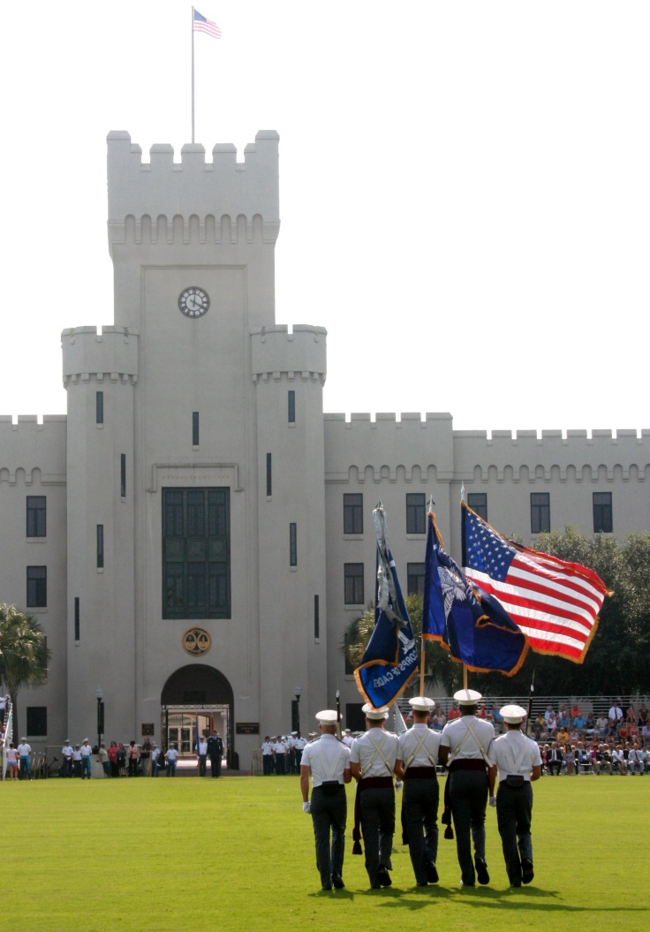
Building Trusting Relationships
Students need to feel as though the mentor cares them; students are the primary focus
Actively show that you care
Learn about them and their situation
Be consistent
Show up every time (can lose any progress)
Be relatable
Demonstrate you can help
Show you know what you’re doing
Establish goals
Keep students on track and looking forward
Be approachable/reachable
Establish a safe way to contact you

Slide 9
Covering Topics and/or Skills
Organizational Skills
Binders (hole-punch, dividers) vs. folders (inhibit organization)
Time Management
Agenda/planner, thinking ahead (sports practice)
School Skills
Study: type of learner, flashcards, stress ball, music
In class: stay awake, quiet, respectful, don’t talk back
Life Skills
Conflict resolution, patience, leadership, responsibility, adulthood
How to make a paper airplane
Mentoring is a brain to pick, an ear to listen, and a push in the right direction."-
John Crosby

Slide 10
Outcomes/Impact: K-12 Students
Provided opportunity to connect and talk about their dreams with successful college students to whom they could relate
Increased organizational abilities
Allowed opportunity for one-on-one assistance on assignments in areas of difficulty
Learned/improved skills for completing tasks
Life: conflict resolution, patience, leadership, responsibility, adulthood
School: study habits, how to read critically, linking subject material to real life (and other subjects)

Slide 11
Outcomes/Impact: College Students
Learned importance of being a constructive role model and building positive relationships
Provided opportunity to serve local community
Provided satisfaction of seeing students progress
Learned that students rise to expectations
Taught preservice teachers the importance of teaching organizational skills to their future students
Allowed preservice teachers experience with students with exceptionalities
Improved preservice teacher communication skills with students

Slide 12
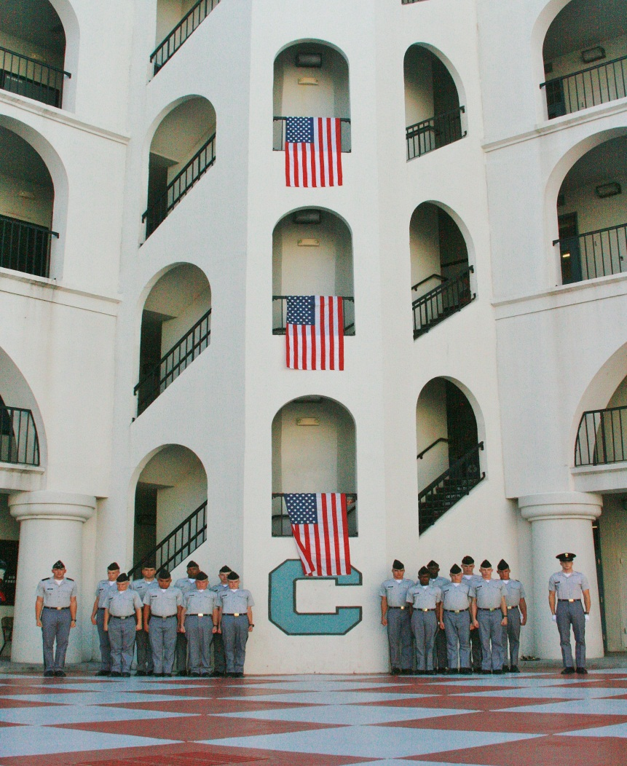
Lessons Learned
Work out logistics before visit (call ahead)
Have goals for each visit (create a plan)
Learn names quickly (both ways)
Visit once weekly (consistency is key)
Be interactive (“guide on the side”)
Have high expectations (they will meet them)
Be supportive (listen and give advice when appropriate)
Be understanding (lots of pressures, including sleep)
Make mentoring a priority (stay engaged; have an impact)

Slide 13
Ideas for Replicating
Look for opportunities to build relationships with local schools
Listen to needs of school
Review research on mentoring
Develop partnership based on needs and best practices
Find positive, reliable mentors; think of personalities and goals when matching with schools
Help with logistics
Provide tips to mentors (lunch meetings, emails, etc.)
Follow-up with schools (emails, phone calls, visits, etc.)
Follow-up with mentors (emails, lunch meetings, etc.)
Be willing to make changes if needed

Slide 14
References
Anastasia, T. T., Skinner, R. L., & Mundhenk, S. E. (2012). Youth mentoring: Program and mentor best practices. Journal of Family and Consumer Sciences, 104(2), 38-44.

Slide 15
Presenters
Traceel Andrews
Cadet Recruiting Sergeant
Matthew Harris
Cadet Squad Corporal
Ra’Shaud Graham
Cadet Platoon Sergeant
James McManus
Cadet Master Sergeant &
Regimental Public Affairs NCO
Tammy J. Graham, Ed.D.
Association Professor
tammy.graham@citadel.edu

